Slide 1


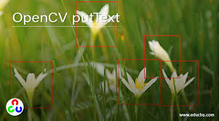
Session 8:
Adding Text to Images

Slide 2
Add Text Example 1
import cv2
# Load an image
image = cv2.imread("flower.jpg")
# cv2.putText(image, text, position, font, font_scale, color, thickness)
cv2.putText(image, "Hello World!", (50, 100), cv2.FONT_HERSHEY_SIMPLEX, 1, (255, 0, 0), 2)
# Display the image
cv2.imshow("Image with Rectangle", image)
# Wait for a key press and close windows
cv2.waitKey(0)
cv2.destroyAllWindows()

Slide 3
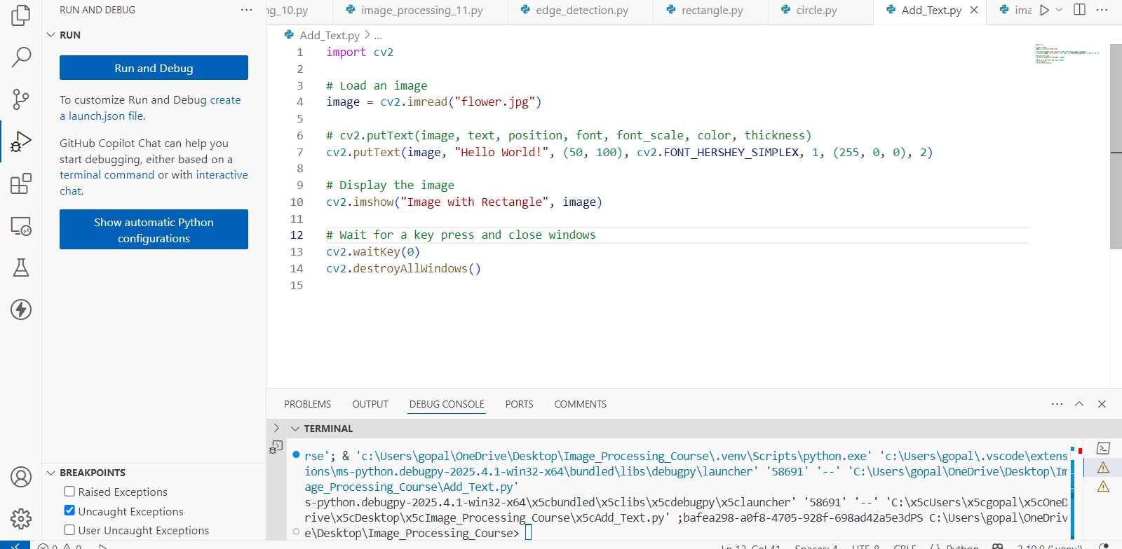

Slide 4
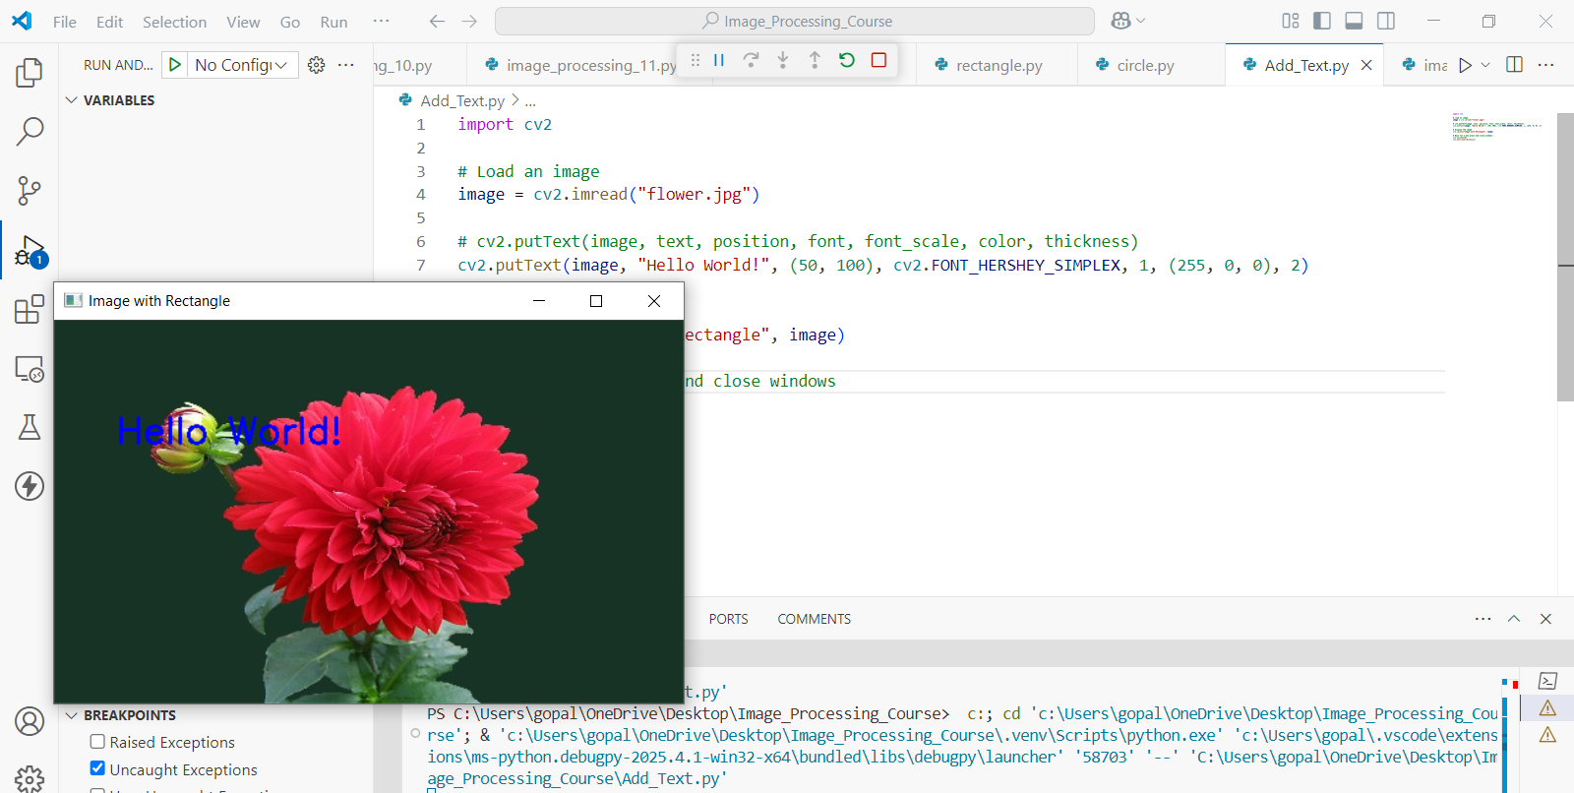
Draw a Green Circle

Slide 5
Add Text Example 2
import cv2
# Load an image
pic = cv2.imread("flower.jpg")
# Check if image loaded successfully
if pic is None:
print("Error: Image not found! Check the file path.")
else:
# Define parameters for putText (without commas at the end)
image = pic # Image to draw on (no comma)
text = "OMOTEC" # Text to display
position = (50, 50) # Position (x, y from top-left) (no comma)
font = cv2.FONT_HERSHEY_SIMPLEX # Font style
font_scale = 1 # Font size
color = (0, 255, 0) # Color (BGR: Green)
thickness = 2 # Thickness

Slide 6
Add Text Example 2
# Add text to the image
cv2.putText(image, text, position, font, font_scale, color, thickness)
# Display the labeled image
cv2.imshow("Labeled Image", pic)
cv2.waitKey(0) # Press any key to close
cv2.destroyAllWindows()

Slide 7

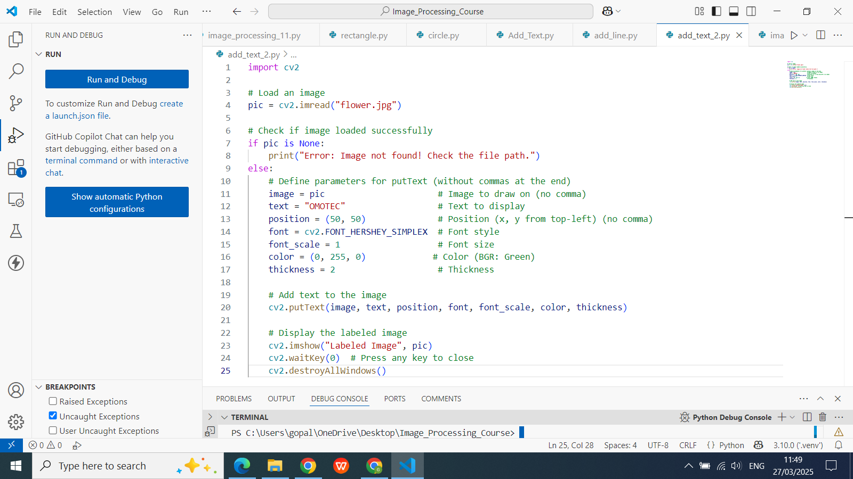

Slide 8
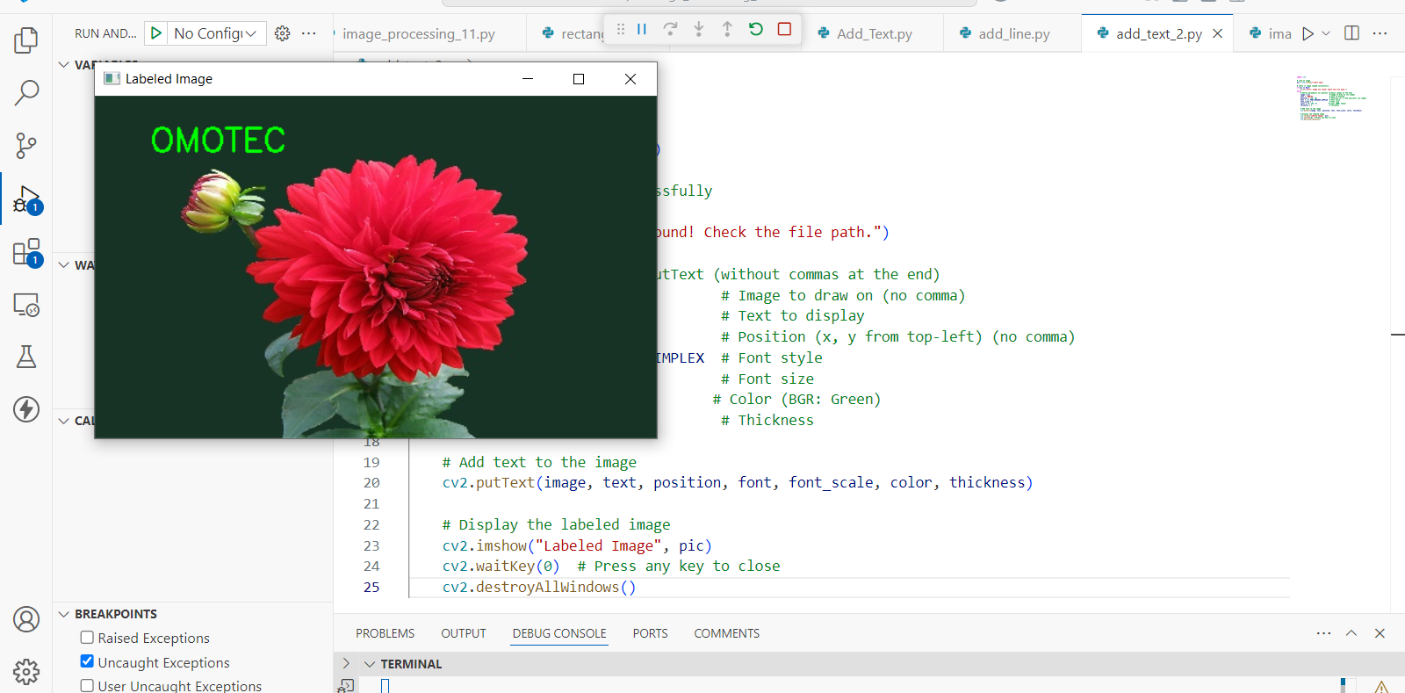

Slide 9
Write a Python script to add text annotations to an image with different font styles.
import cv2
import numpy as np
# Create a blank white image (600x400 pixels)
image = np.ones((400, 600, 3), dtype=np.uint8) * 255 # White background
# Define text annotations with different styles
annotations = [
{"text": "Regular Font", "pos": (50, 50), "font": cv2.FONT_HERSHEY_SIMPLEX, "scale": 1, "color": (0, 0, 0), "thickness": 1},
{"text": "Fancy Font", "pos": (50, 100), "font": cv2.FONT_HERSHEY_SCRIPT_SIMPLEX, "scale": 1, "color": (255, 0, 0), "thickness": 2},
{"text": "BOLD TEXT", "pos": (50, 150), "font": cv2.FONT_HERSHEY_DUPLEX, "scale": 1, "color": (0, 0, 255), "thickness": 2},
{"text": "Italic Style", "pos": (50, 200), "font": cv2.FONT_HERSHEY_SIMPLEX | cv2.FONT_ITALIC,

Slide 10
Write a Python script to add text annotations to an image with different font styles…
"scale": 1, "color": (0, 100, 0), "thickness": 1},
{"text": "Large Text", "pos": (50, 250), "font": cv2.FONT_HERSHEY_COMPLEX, "scale": 1.5, "color": (128, 0, 128), "thickness": 2},
{"text": "Thick Outline", "pos": (50, 300), "font": cv2.FONT_HERSHEY_PLAIN, "scale": 1.5, "color": (0, 0, 0), "thickness": 3}
]
# Add all annotations to the image
for annotation in annotations:
cv2.putText(
image,
annotation["text"],
annotation["pos"],
annotation["font"],
annotation["scale"],
annotation["color"],
Annotation["thickness"] )

Slide 11
Write a Python script to add text annotations to an image with different font styles…
# Display the image
cv2.imshow("Text Annotations with Different Fonts", image)
cv2.waitKey(0)
cv2.destroyAllWindows()
# Save the result
cv2.imwrite("text_annotations.jpg", image)

Slide 12
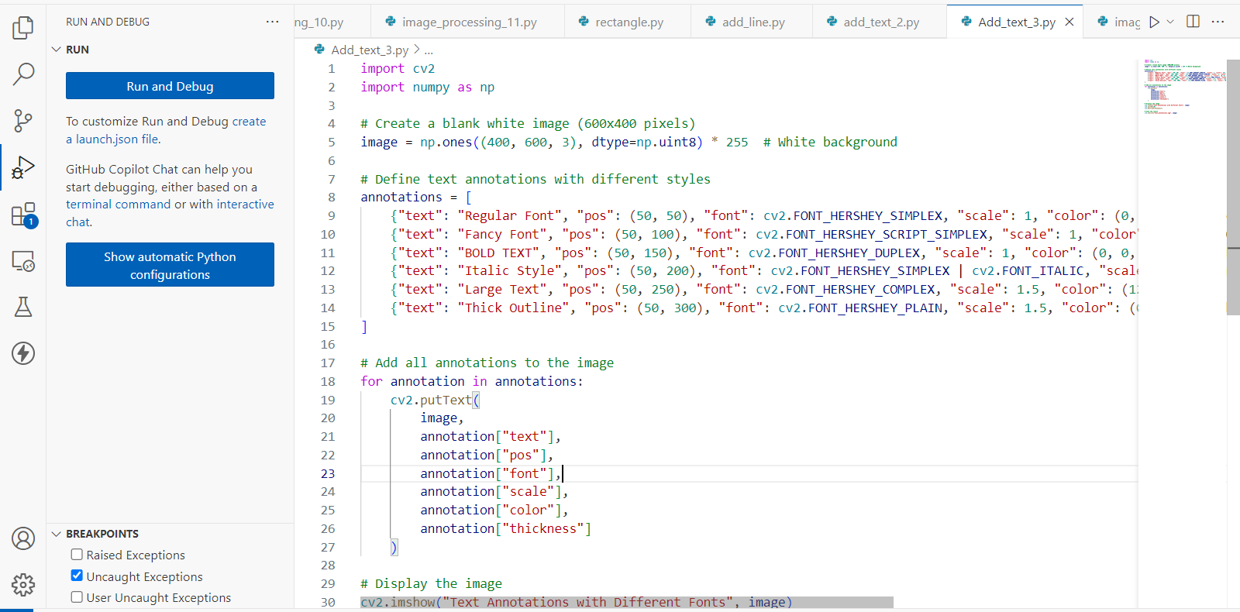

Slide 13
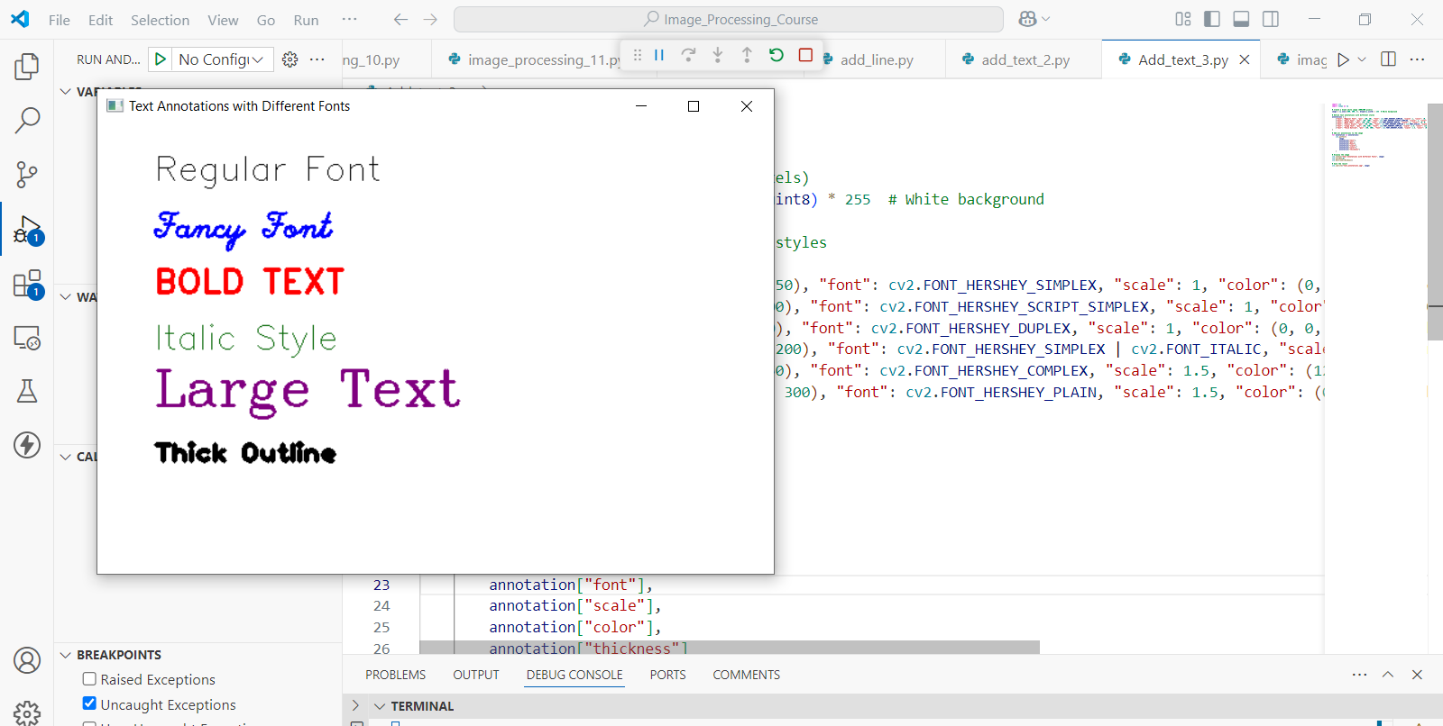

Slide 14
Exercise
1. What OpenCV function is used to add text to an image? A. cv2.writeText() B. cv2.putText() C. cv2.addText() D. cv2.text()
Correct Answer: B. cv2.putText()
2. What does the parameter (0, 255, 0) represent in the cv2.putText() function? A. Blue color in RGB B. Red color in BGR C. Green color in BGR D. Yellow color in RGB
Correct Answer: C. Green color in BGR

Slide 15
Exercise
3. Which of the following is a valid OpenCV font used to display "Fancy Font"? A. cv2.FONT_HERSHEY_SIMPLEX B. cv2.FONT_HERSHEY_SCRIPT_SIMPLEX C. cv2.FONT_HERSHEY_COMPLEX D. cv2.FONT_HERSHEY_DUPLEX
Correct Answer: B. cv2.FONT_HERSHEY_SCRIPT_SIMPLEX
4. What value should you use for the thickness parameter to draw bold text in OpenCV? A. 0 B. 1 C. 2 or higher D. -1
Correct Answer: C. 2 or higher

Slide 16
Exercise
5. What happens if you set cv2.putText() with cv2.FONT_HERSHEY_SIMPLEX | cv2.FONT_ITALIC? A. The text becomes underlined B. The text becomes italicized C. An error occurs D. The text gets bold
Correct Answer: B. The text becomes italicized

